Slide 1
Final Group Project
By: Mohammed Khan, Andrew Lee, Rohan Jose, John Hernandez

Slide 2
Our Global Terrorism Database Collection
We pulled 20 Tables from https://www.start.umd.edu/data-tools/global-terrorism-database-gtd
The different categories we had for the tables were: Location, time/date, terror_event, attack_details, target, weapon, group, motive, group_details, casualties/victims, damage, ransom, source
After adding some relationships between the tables, some were generated thereby generating an extra 5 tables in addition to the ones added previously
We used data from 50 entries in the GTD
The timetable for the data in this database ranges from January 1970 to July 1970.

Slide 3
Groups Involved
The type of perpetrator groups involved were:
Student radicals (USA)
Black nationalists (USA)
Left-wing militants (USA and East Germany)
White supremacists and other right-wing supremacists (USA and Eastern Germany)
Jewish Defense League (USA)
Extra Parliamentary Opposition (GER)
PFLP (GER)

Slide 4
Target Type
This table focused on what Organizations/Groups the perpetrators focused their attacks on.
It included:
Businesses, (GER & US)
Educational Institutions (U.S.)
Police, (GER & US)
Private Citizens & Property, (GER & US)
Religious Institutions, etc. (U.S.)

Slide 5
Country: United States
The type of attacks listed in the U.S. ranged from different perpetrators and each had different methods. For example, there are multiple attacks of the same type of perpetrator group but some may have been a bombing and the other was a facility/infrastructure attack. Other factors also contribute like the cost of damage.
Events leading up to 1970:
Democratic Party split
Richard Nixon Elected
MLK Jr and Robert Kennedy assassinated
Anti-War protest around the country
Urban Riots

Slide 6
Country: Germany
After WW2, Germany was split into two - West Germany and East Germany. During the 70s, Both nations experienced a big spike in terrorism and crime both for and against the inevitable reunification of Germany. Notable perpetrators were mostly left-wing extremists such as the Red Army Faction, the Rote Zora in addition to other leftist terrorist cells.
Events leading up to 1970:
-Berlin Wall built -West Germany Protest Movement -Treaty between France and Germany -Treaty of warsaw signed -68ers

Slide 7
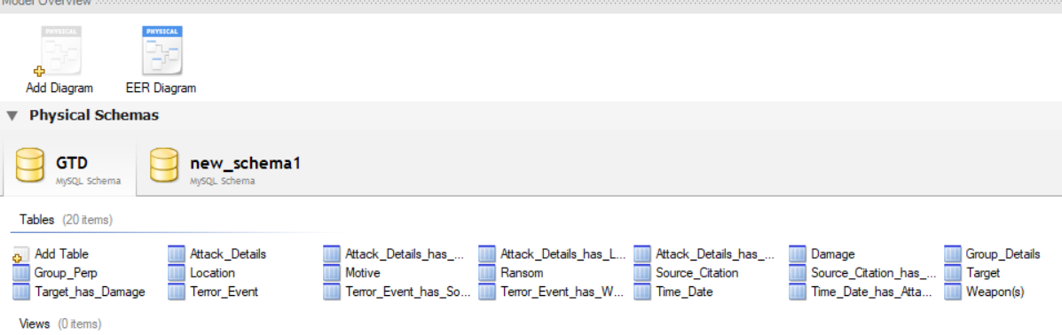
All Tables in our Global Terrorism Database

Slide 8
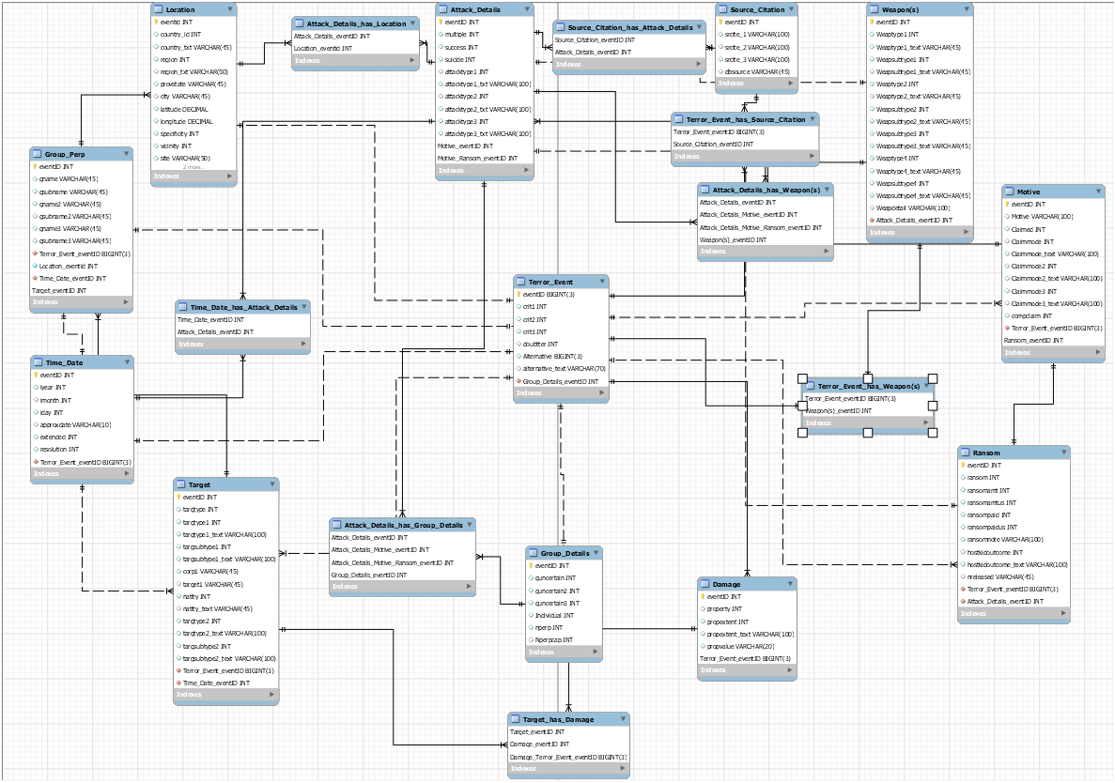
EER between GTD Tables

Slide 9
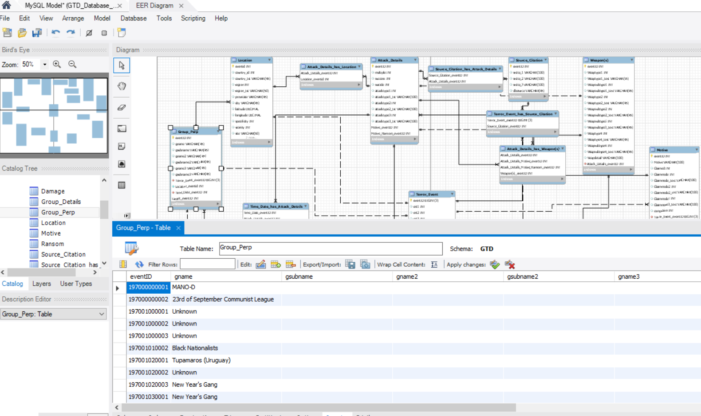
All Tables with their respective Data as shown below

Slide 10
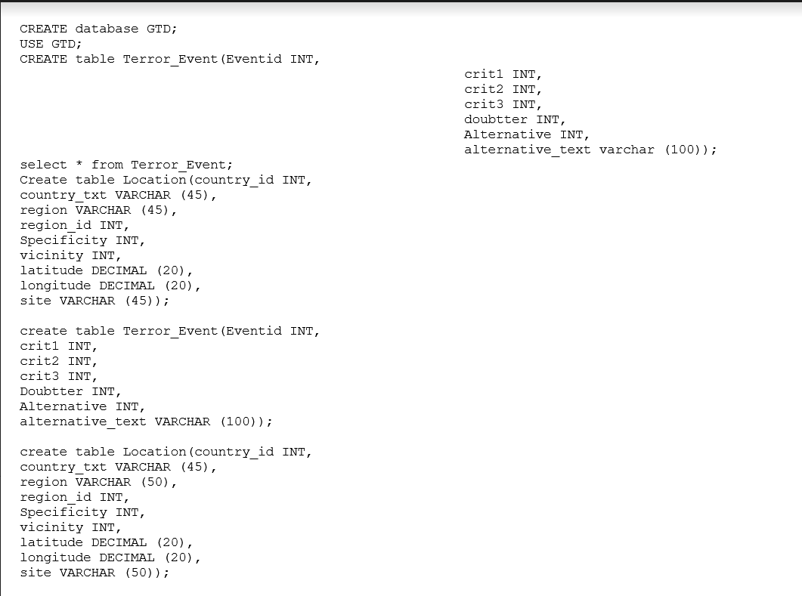
SQL Query Script

Slide 11
Sources
https://www.start.umd.edu/gtd/search/Results.aspx?expanded=no&casualties_type=b&casualties_max=&start_year=1970&start_month=1&start_day=1&end_year=1970&end_month=7&end_day=1&dtp2=all&success=yes&country=217&ob=GTDID&od=desc&page=1&count=50#results-table
https://www.start.umd.edu/gtd/search/Results.aspx?page=1&casualties_type=b&casualties_max=&start_year=1970&start_month=1&start_day=1&end_year=1970&end_month=7&end_day=31&dtp2=all&country=499,75,362&charttype=line&chart=overtime&ob=GTDID&od=desc&expanded=yes#results-table

